Slide 1
FLUIDS: States of Matter, Hydrodynamics & Hydrostatics

Slide 2
States of Matter
Solid
  Has a definite volume and shape
Liquid
  Has a definite volume but not a definite shape
Gas – unconfined
  Has neither a definite volume nor shape
All of these definitions are somewhat artificial.
More generally, the time it takes a particular substance to change its shape in response to an external force determines whether the substance is treated as a solid, liquid or gas.

Slide 3
Fluids
A fluid is a collection of molecules that are randomly arranged and held together by weak cohesive forces and by forces exerted by the walls of a container.
Both liquids and gases are fluids.

Slide 4
Statics and Dynamics with Fluids
Fluid Statics
  Describes fluids at rest
Fluid Dynamics
  Describes fluids in motion
The principles that have already been discussed will also apply to fluids.

Slide 5
Forces in Fluids
Fluids do not sustain shearing stresses or tensile stresses.
The only stress that can be exerted on an object submerged in a static fluid is one that tends to compress the object from all sides.
The force exerted by a static fluid on an object is always perpendicular to the surfaces of the object.

Slide 6
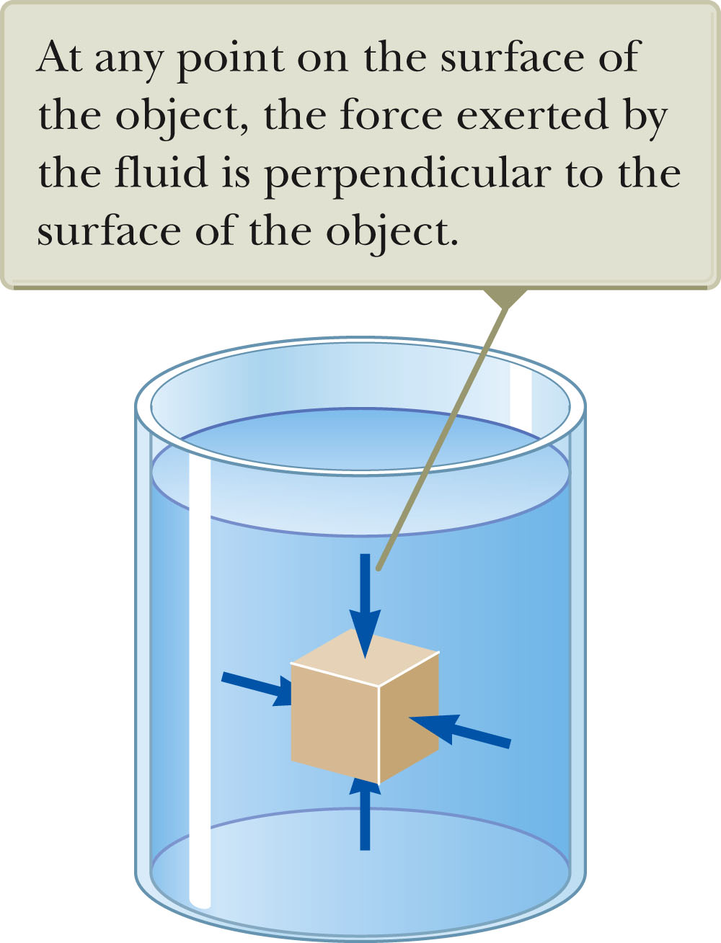
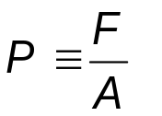

Pressure
The pressure P of the fluid at the level to which the device has been submerged is the ratio of the force to the area.
Pressure is a scalar quantity.
  Because it is proportional to the magnitude of the force.
Unit of pressure is pascal (Pa)

Slide 7
Pressure vs. Force
Pressure is a scalar and force is a vector.
The direction of the force producing a pressure is perpendicular to the area of interest.

Slide 8
Density Notes
Density is defined as the mass per unit volume of the substance.
The values of density for a substance vary slightly with temperature since volume is temperature dependent.
The various densities indicate the average molecular spacing in a gas is much greater than that in a solid or liquid.

Slide 9
Variation of Pressure with Depth
Fluids have pressure that varies with depth.
If a fluid is at rest in a container, all portions of the fluid must be in static equilibrium.
All points at the same depth must be at the same pressure.
  Otherwise, the fluid would not be in equilibrium.
    This is independent of the shape of the container.

Slide 10
Pressure and Depth
The pressure P at a depth h below a point in the liquid at which the
pressure is P₀ is greater by an amount gh.
  P = P₀ + ρ g h
Atmospheric Pressure, P_{o}
If the liquid is open to the atmosphere, and P₀ is the pressure at the surface of the liquid, then P₀ is atmospheric pressure.
P₀ = 1.00 atm = 1.013 x 10⁵ Pa

Slide 11
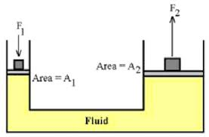
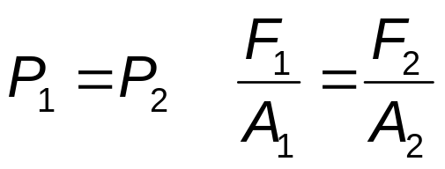
Pascal’s Law
The pressure in a fluid depends on depth and on the value of P_{0.}
An increase in pressure at the surface must be transmitted to every other point in the fluid.
This is the basis of Pascal’s law.
  Named after French scientist Blaise Pascal.
Pascal’s Law states a change in the pressure applied to a fluid is transmitted undiminished to every point of the fluid and to the walls of the container.

Slide 12
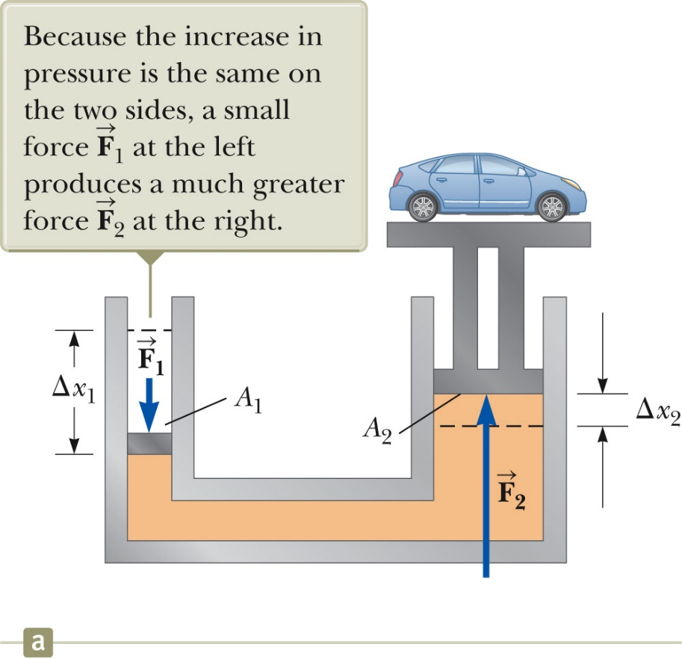


Pascal’s Law, Example
An important application of Pascal’s Law is a hydraulic press (right).
A large output force can be applied by means of a small input force.
The volume of liquid pushed down on the left must equal the volume pushed up on the right.
Since the volumes are equal,
Combining the equations,
  which means Work₁ = Work₂
  This is a consequence of Conservation of Energy.

Slide 13
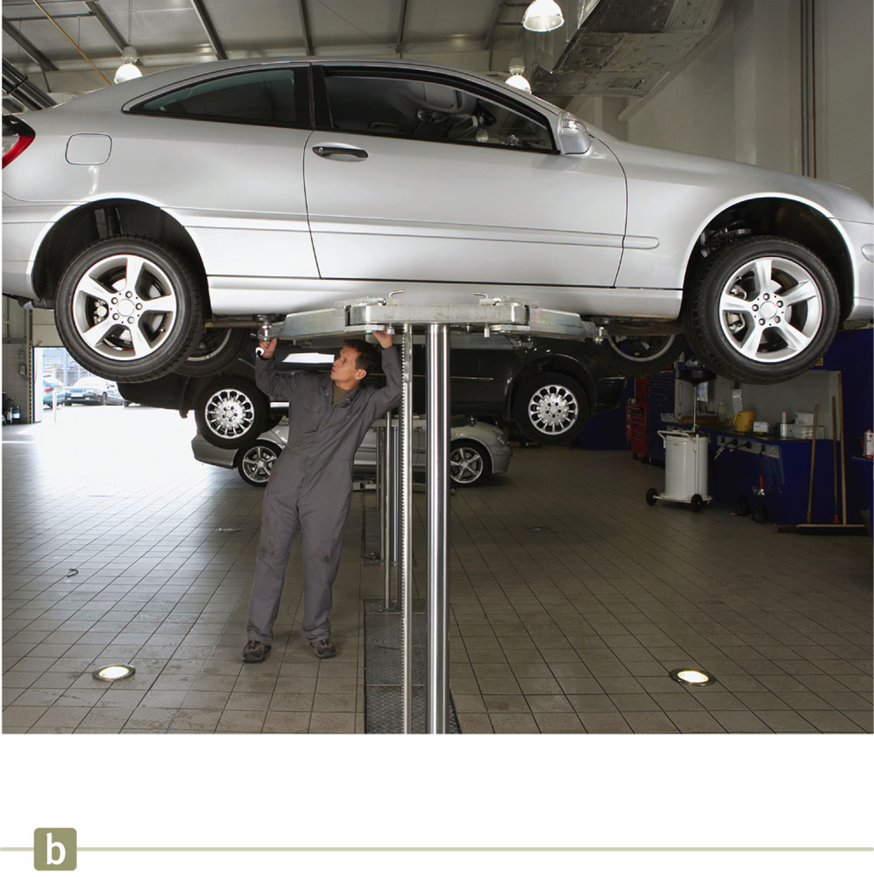
Pascal’s Law, Other Applications
Hydraulic brakes
Car lifts
Hydraulic jacks
Forklifts

Slide 14
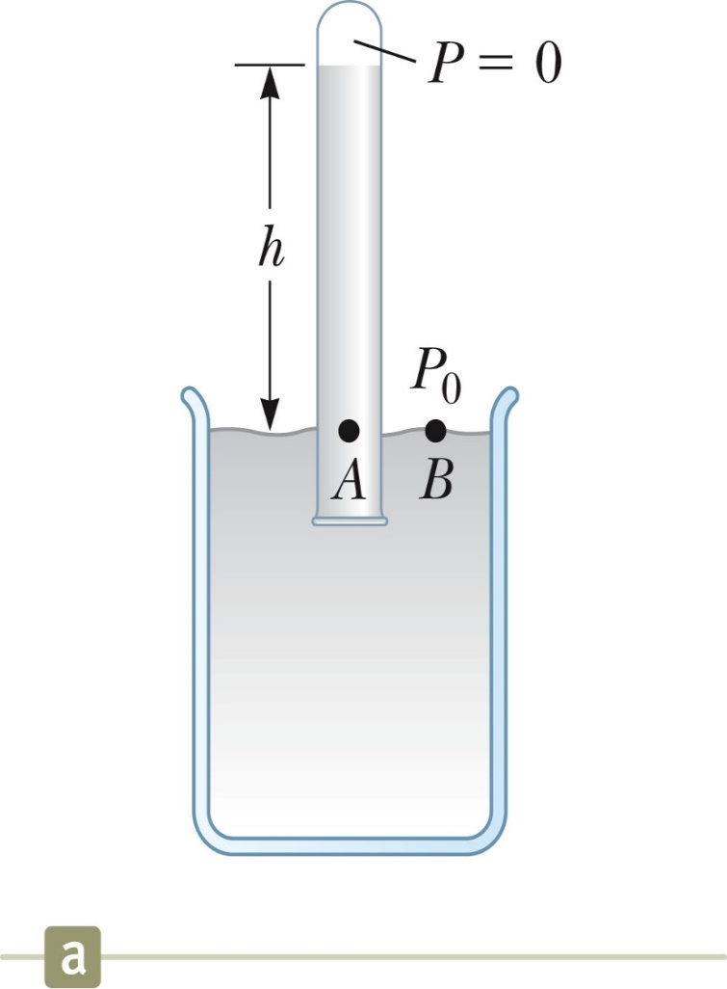
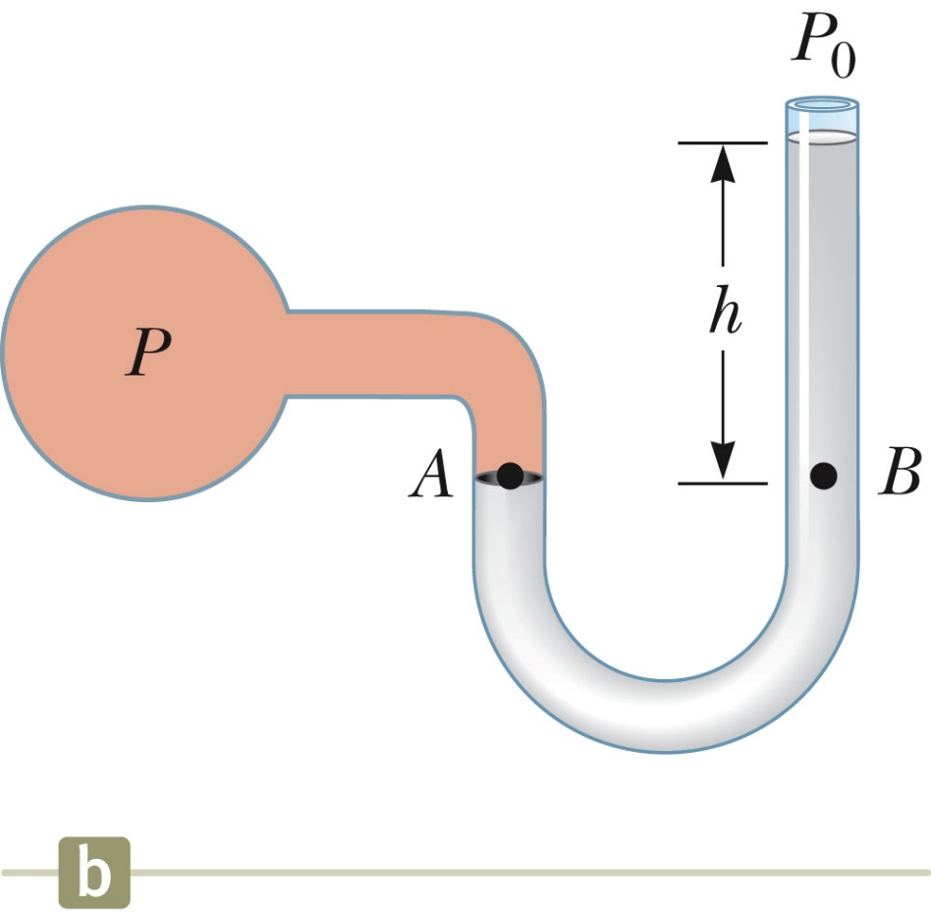
Instruments for Pressure Measurements
1. Barometer:
2. Manometer: A device for measuring the pressure of a gas contained in a vessel.

Slide 15
Absolute vs. Gauge Pressure
P = P₀ + ρ g h
P is the absolute pressure.
The gauge pressure is P – P_{0.}
  This is also ρ g h.
  This is what you measure in your tires.

Slide 16
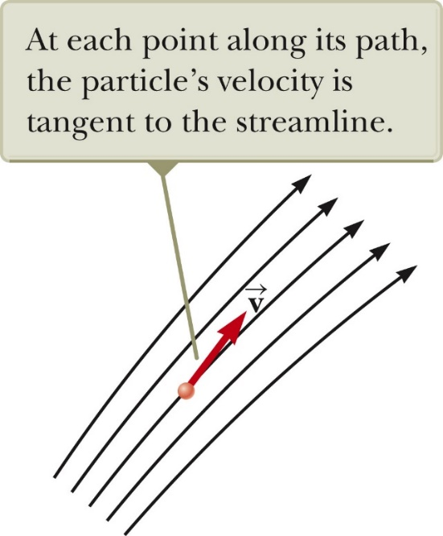
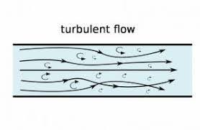
Types of Fluid Flow
Laminar flow
  Steady flow
  Each particle of the fluid follows a smooth path.
  The paths of the different particles never cross each other.
  Every given fluid particle arriving at a given point has the same velocity.
Turbulent flow
  An irregular flow characterized by small whirlpool-like regions.
  Turbulent flow occurs when the particles go above some critical speed.

Slide 17
Viscosity
Characterizes the degree of internal friction in the fluid.
This internal friction, or viscous force, is associated with the resistance that two adjacent layers of fluid have when moving relative to each other.
It causes part of the kinetic energy of a fluid to be converted to internal energy.

Slide 18
Ideal Fluid Flow
There are four simplifying assumptions made to the complex flow of fluids to make the analysis easier .
  The fluid is non-viscous – internal friction is neglected
    An object moving through the fluid experiences no viscous forces.
  The flow is steady – all particles passing through a point have the same velocity.
  The fluid is incompressible – the density of the incompressible fluid remains constant.
  The flow is irrotational – the fluid has no angular momentum about any point.

Slide 19

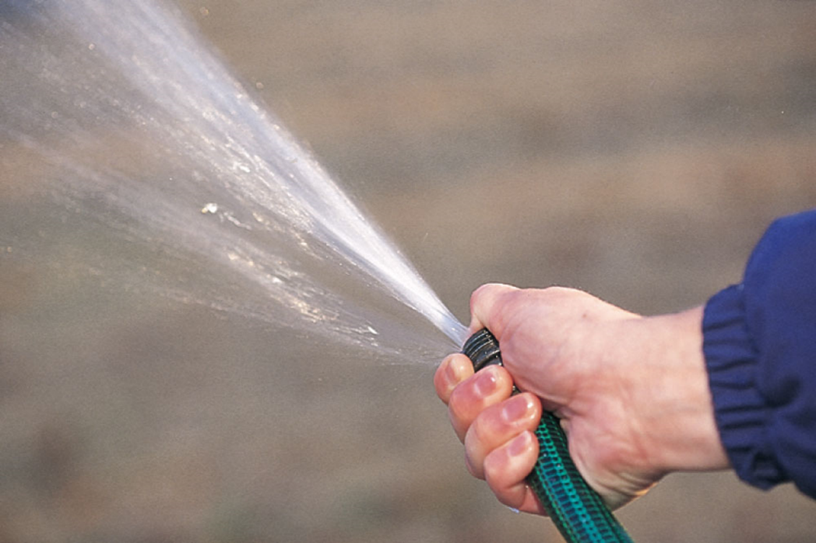
Streamlines
The path the particle takes in steady flow is a streamline.
The velocity of the particle is tangent to the streamline.
A set of streamlines is called a tube of flow.
Fluid particles cannot flow into or out of the sides of this tube .
  Otherwise the steamlines would cross each other.

Slide 20
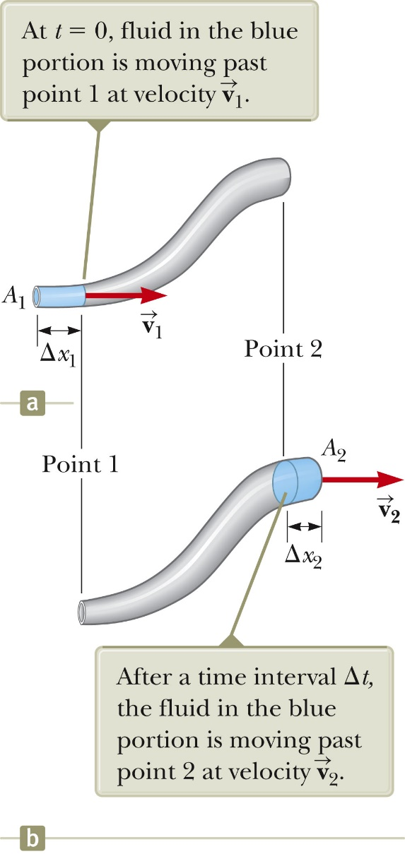
Equation of Continuity
Consider a fluid moving through a pipe of non-uniform size (diameter).
Consider the small blue-colored portion of the fluid.
At t = 0, the blue portion is flowing through a cross section of area A₁ at speed v₁.
At the end of Δt , the blue portion is flowing through a cross section of area A₂ at speed v₂.
The mass that crosses A₁ in some time interval is the same as the mass that crosses A₂ in that same time interval.

Slide 21
Equation of Continuity
m₁ = m₂ or ρ A₁v₁ Δt = ρ A₂v₂ Δt
The fluid is incompressible, so ρ is a constant, and flow is constant.
A₁v₁ = A₂v₂ = constant
  This is called the equation of continuity for fluids.
  The product of the area and the fluid speed at all points along a pipe is constant for an incompressible fluid.

Slide 22

Equation of Continuity, Implications
The speed is high where the tube is constricted (small A).
The speed is low where the tube is wide (large A).
The product, Av, is called the volume flux or the flow rate.
Av = constant is equivalent to saying the volume that enters one end of the tube in a given time interval equals the volume leaving the other end in the same time.
  If no leaks are present

Slide 23
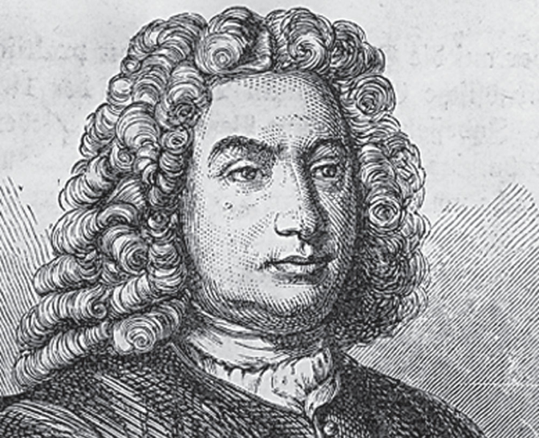
Bernoulli’s Equation
As a fluid moves through a region where its speed and/or elevation above the Earth’s surface changes, the pressure in the fluid varies with these changes.
The relationship between fluid speed, pressure and elevation was first derived by Daniel Bernoulli.

Slide 24
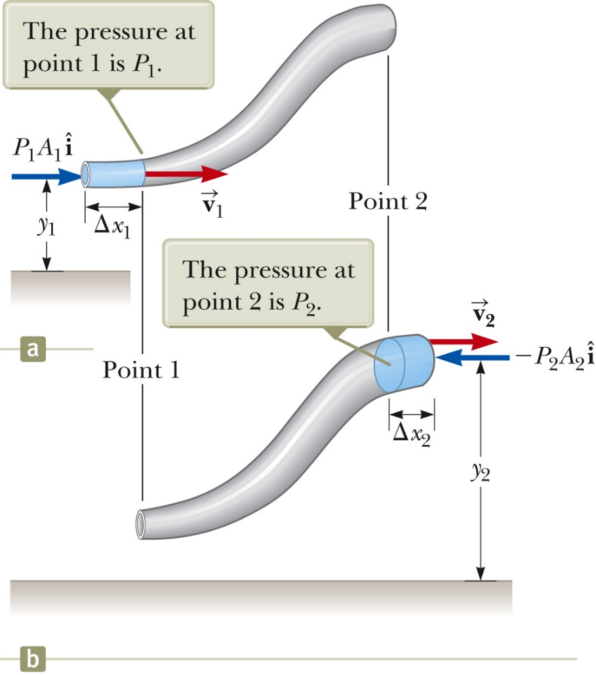
Bernoulli’s Equation
This is Bernoulli’s Equation as applied to an ideal fluid is:
P₁ + ½ ρv₁² + ρgy₁ = P₂ + ½ ρv₂² + ρgy₂
It’s often expressed as
P + ½ ρ v² + ρ g y = constant
When the fluid is at rest, this becomes P₁ – P₂ = ρ g h which is consistent with the pressure variation with depth we found earlier .
The general behavior of pressure with speed is true even for gases.
  As the speed increases, the pressure decreases.

Slide 25
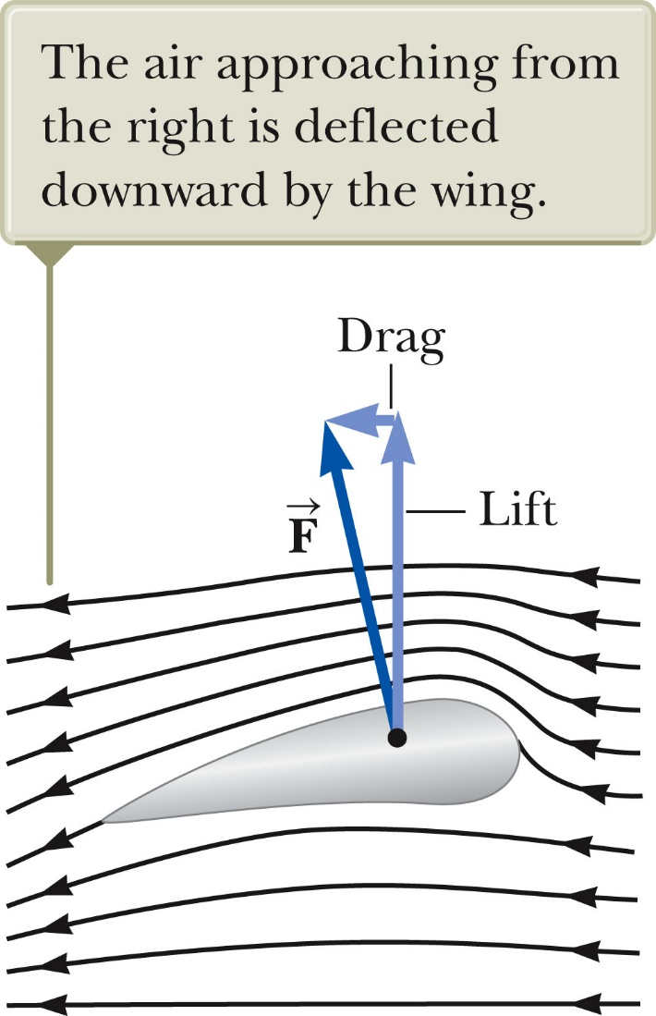
Applications of Fluid Dynamics – Airplane Wing
Streamline flow around a moving airplane wing.
Lift is the upward force on the wing from the air.
Drag is the resistance.
The curvature of the wing surfaces causes the pressure above the wing to be lower than that below the wing due to the Bernoulli effect.
The lift depends on the speed of the airplane, the area of the wing, its curvature, and the angle between the wing and the horizontal.

Slide 26
Lift – General
In general, an object moving through a fluid experiences lift as a result of any effect that causes the fluid to change its direction as it flows past the object.
Some factors that influence lift are:
  The shape of the object
  The object’s orientation with respect to the fluid flow
  Any spinning of the object
  The texture of the object’s surface

Slide 27
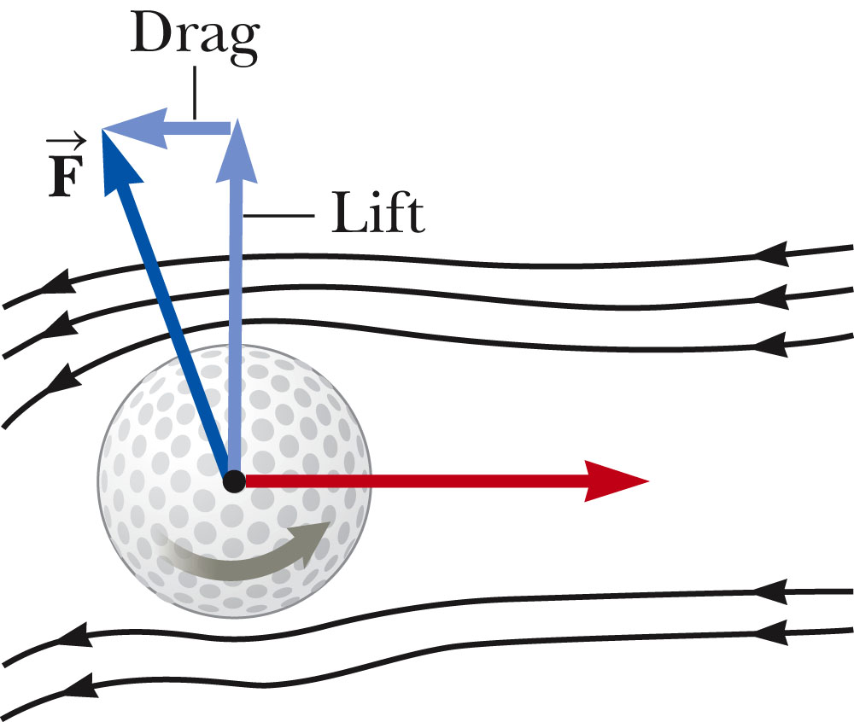
Golf Ball Example
The ball is given a rapid backspin.
The dimples increase friction.
  Increases lift
It travels farther than if it was not spinning.
The lift gained by spinning the ball more than compensates for the loss of range due to the effect of friction on the translational motion of the ball.

